Slide 1
Достопримечательности стран изучаемого языка глазами детей

Slide 2
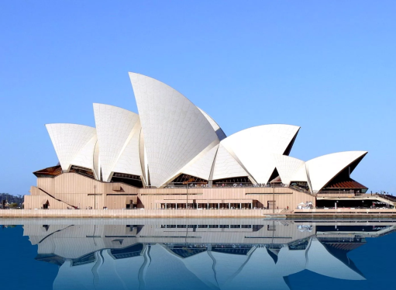
The Sydney Opera House is a multi-venue performing arts centre in Sydney, New South Wales, Australia.

Slide 3
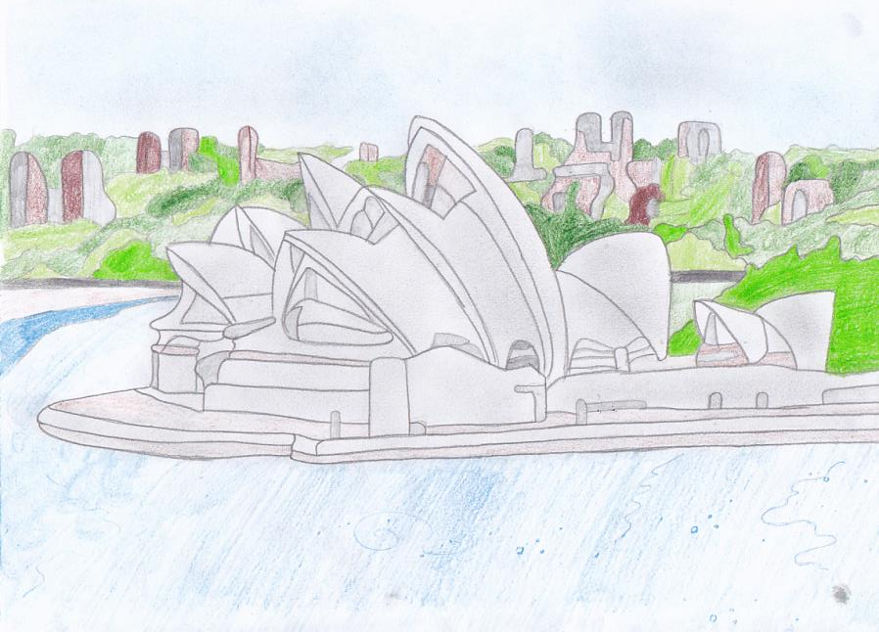

Slide 4
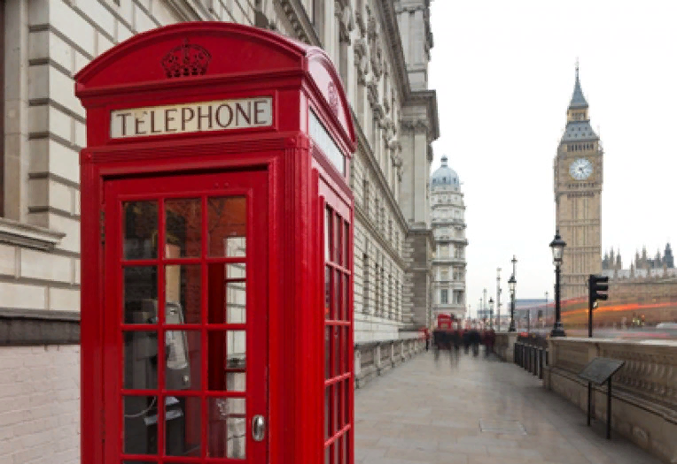
The red telephone box, a telephone kiosk for a public telephone designed by Sir Giles Gilbert Scott, is a familiar sight on the streets of the United Kingdom

Slide 5
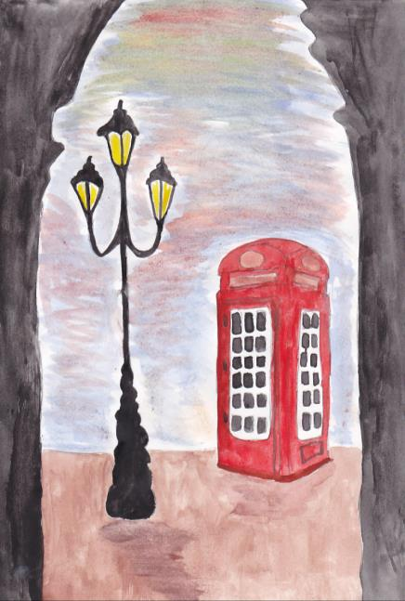
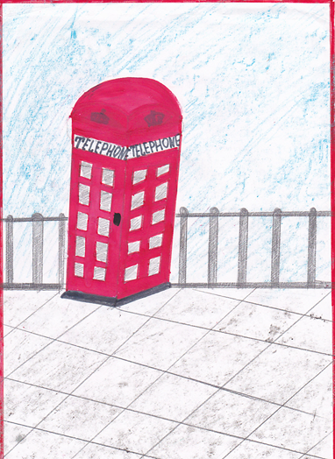

Slide 6
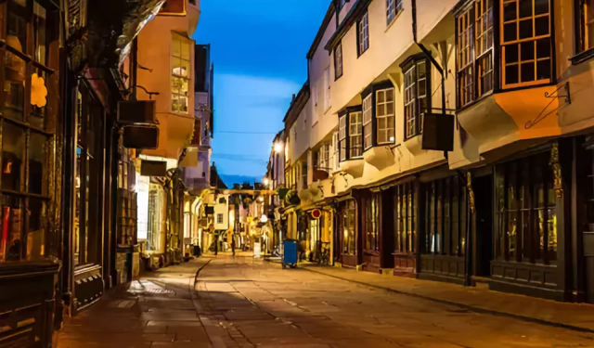
Old Street, York

Slide 7
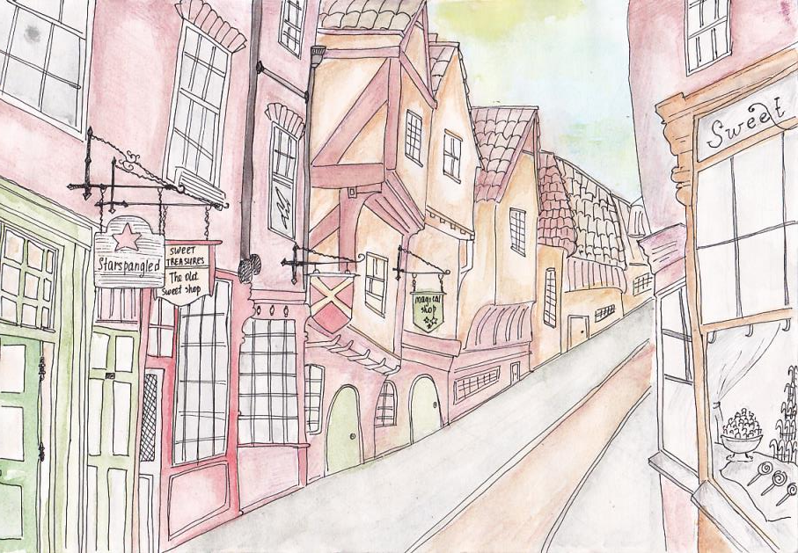

Slide 8
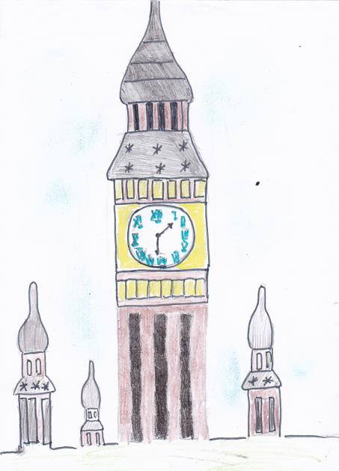

Slide 9
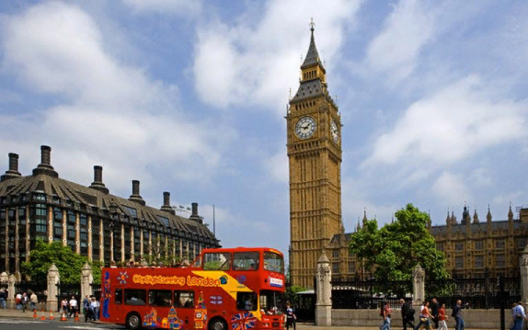
Big Ben is the largest of the six bells in Westminster Palace. Many people think that this is the name of the clock tower in London, but in fact the so-called 13-ton bell is what is inside it, behind the dial.
The official name of Big Ben was the Clock Tower of Westminster Palace. In 2012, by decision of the British Parliament, this landmark of England was renamed the Tower of Elizabeth (in honor of the 60th anniversary of the reign of the Queen).

Slide 10
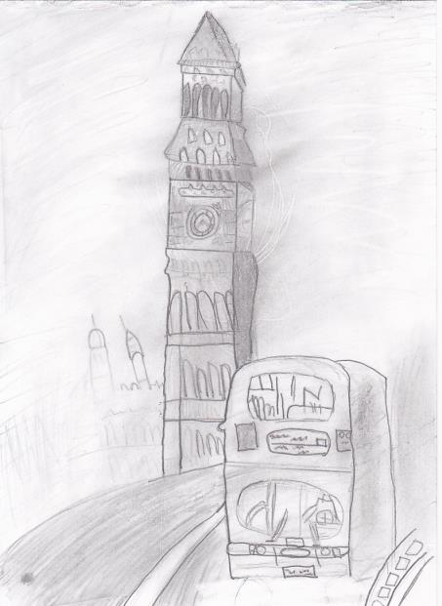
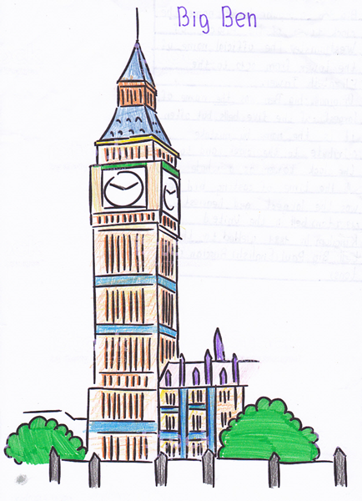

Slide 11
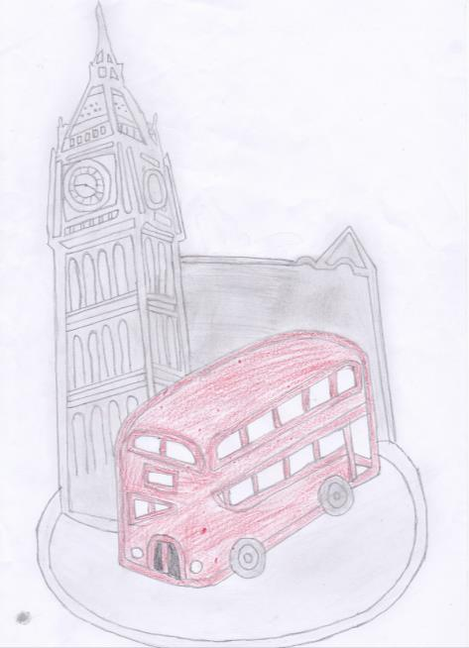

Slide 12
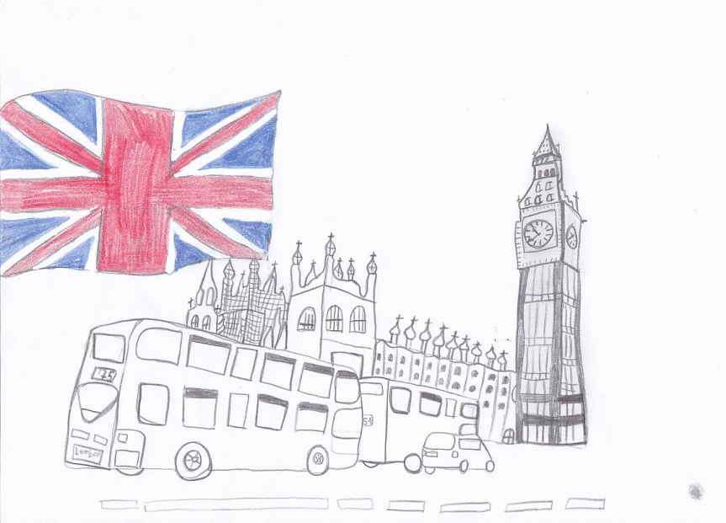

Slide 13
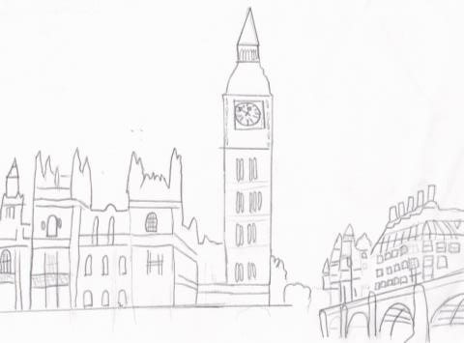
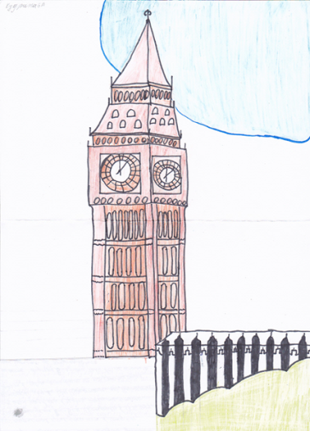

Slide 14
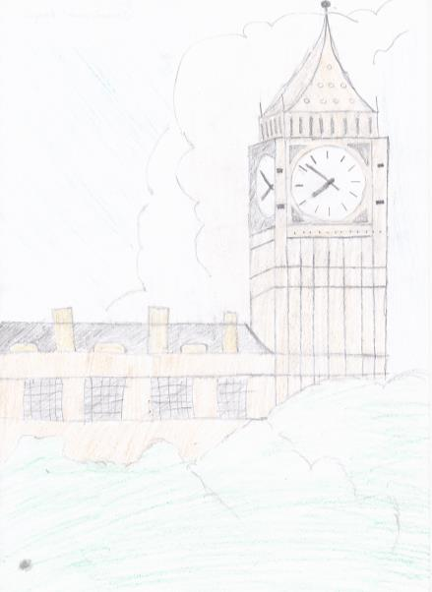
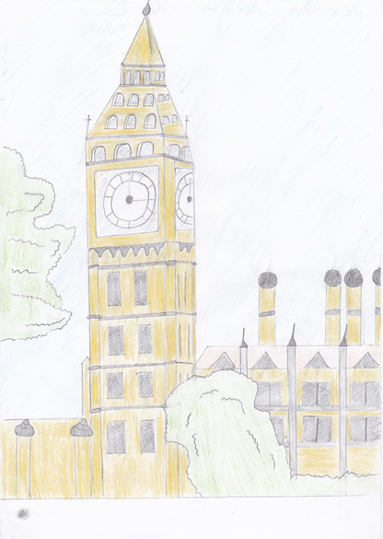

Slide 15
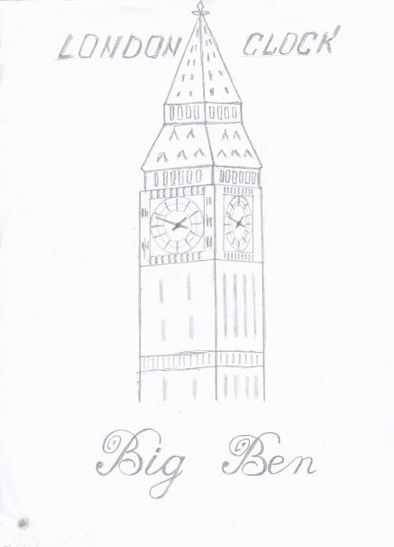
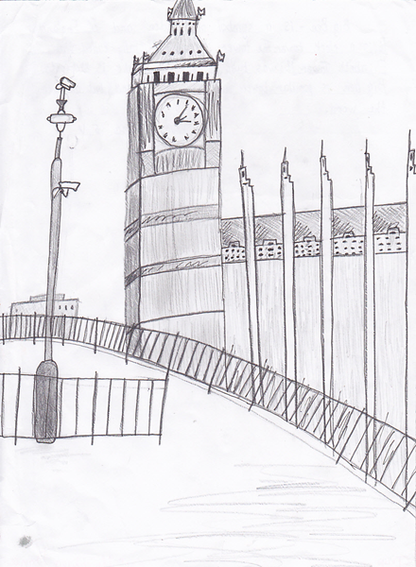

Slide 16
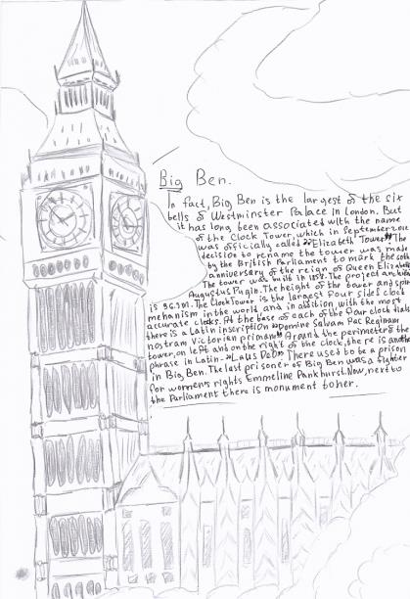
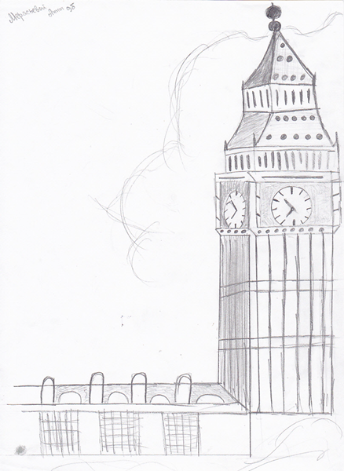

Slide 17
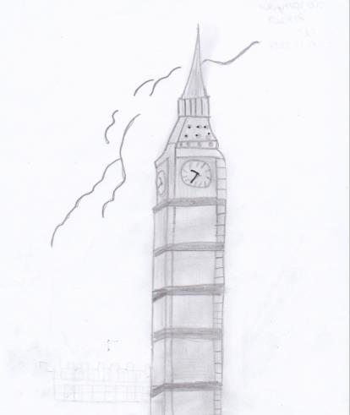
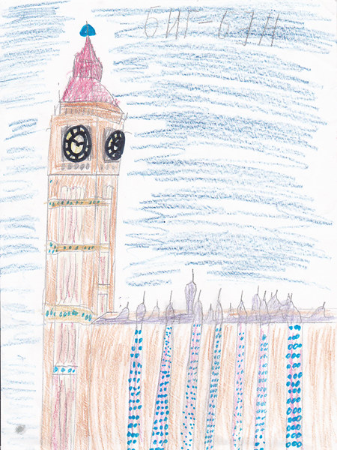

Slide 18
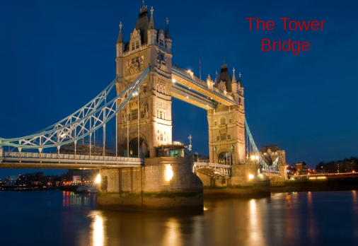
Tower Bridge - 244-meter drawbridge over the River Thames, near the Tower of London. It is one of the symbols of Britain and the most famous bridge in the world. The bridge was designed by Sir Horace Jones and opened in 1894. The central span of 61 meters in length with two wings is equipped with a special lifting mechanism, which in the past was controlled by a steam engine. The bridge offers a beautiful view of the Tower of London and the Thames.
The towers of a bridge 65 meters high connected by galleries, according to which Londoners, hurrying on business or on a date, must move from one bank to another when the bridge was divorced. Today, the bridge is bred irregularly at the request of large ships.

Slide 19
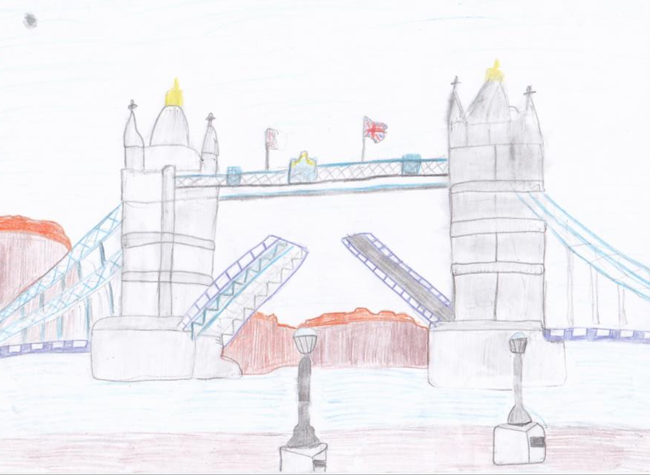

Slide 20
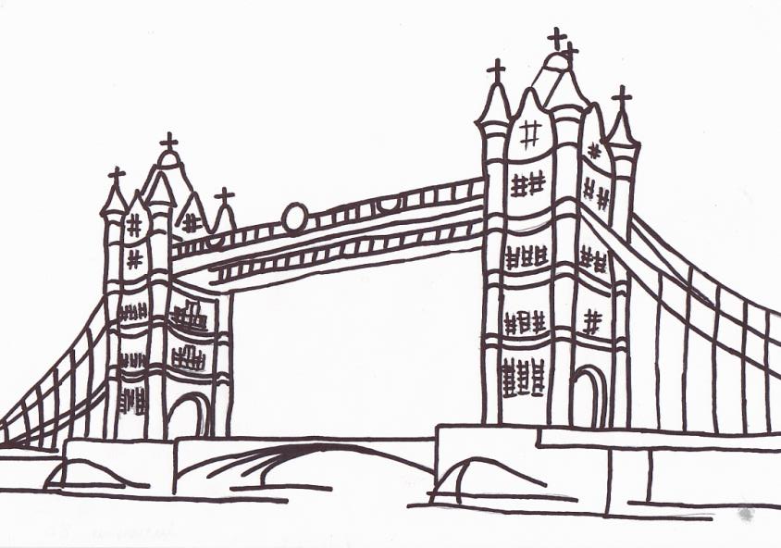

Slide 21
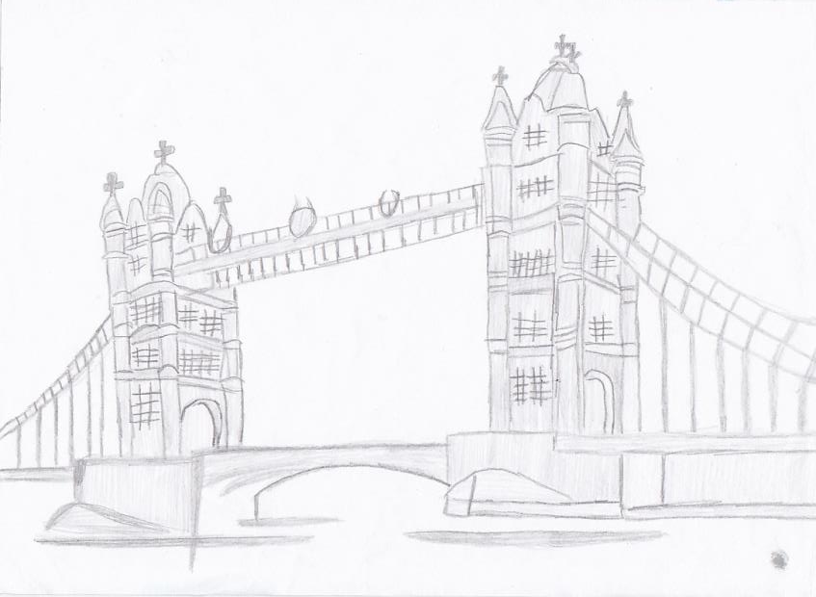

Slide 22
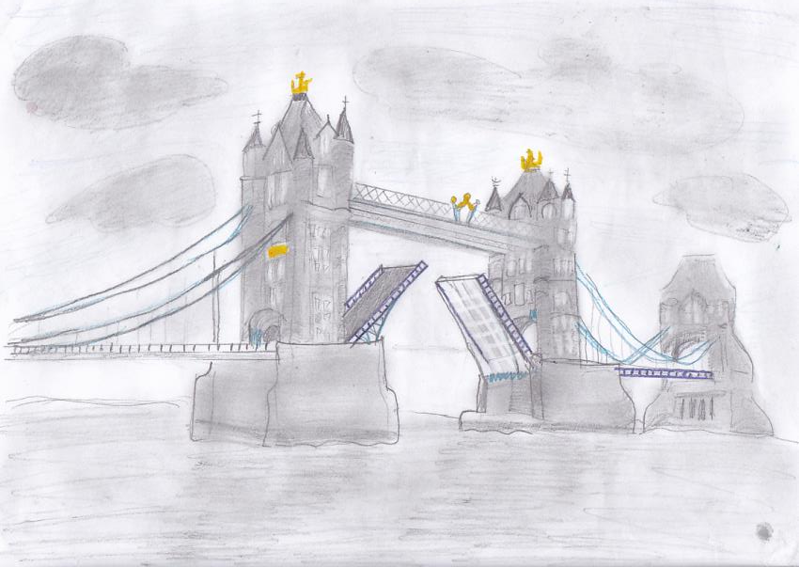

Slide 23
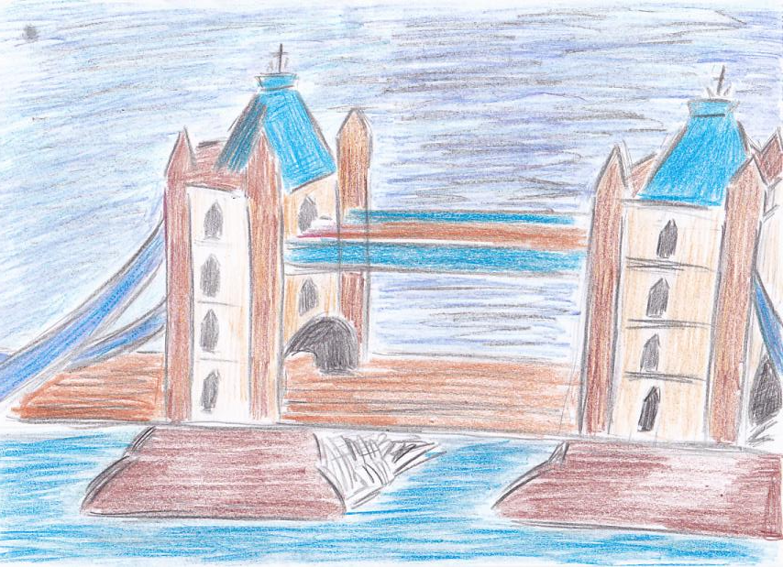

Slide 24
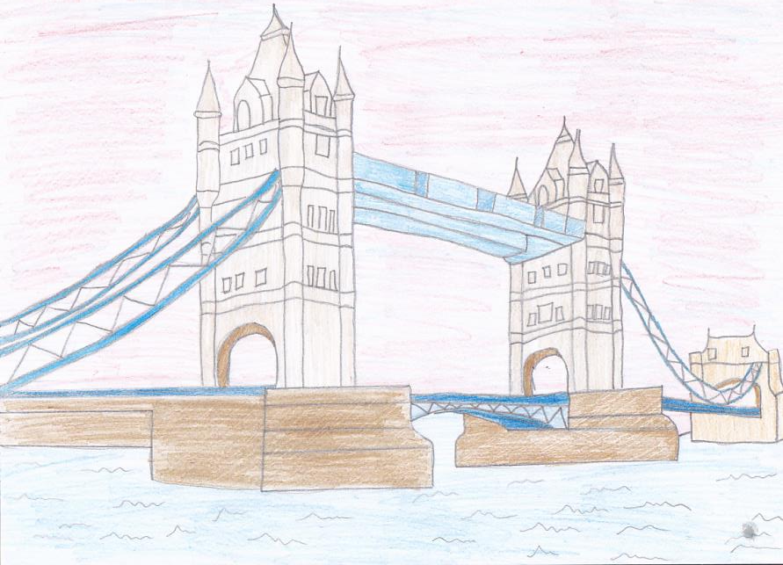

Slide 25
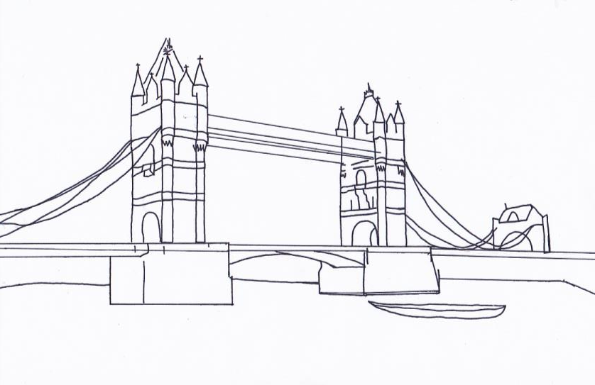

Slide 26
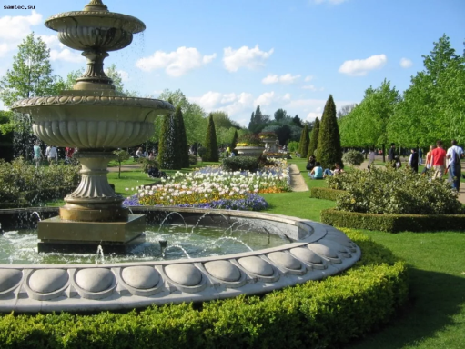
Hyde Park is a large park in London. Londoners love it. On Sunday mornings in summer you can see lots of Londoners sitting with their families on the grass or listening to the music. Some of them are bathing or boating on the lake. Some rich Londoners are riding on horseback. Hyde Park is the place for all kinds of parades and mass meetings. In Hyde Park there is a corner which you can not find anywhere else. That is Speakers Corner. Here you can see many people standing on a box, a chair or a small platform. Each is making a long speech about something.

Slide 27
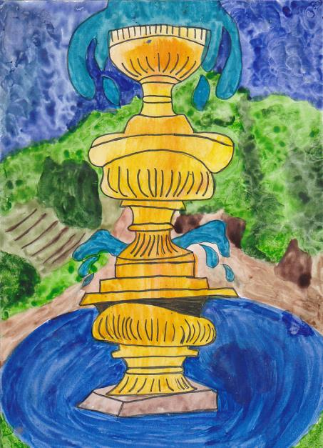

Slide 28
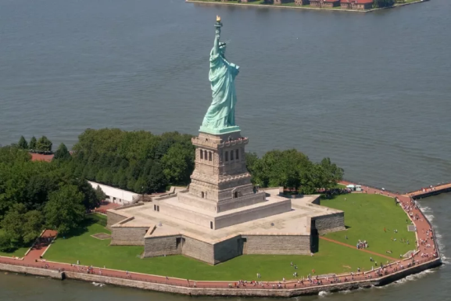
Liberty Enlightening the World (French: La liberté éclairant le monde), known more commonly as the Statue of Liberty (Statue de la Liberté), is a statue given to the United States by the Paris based Union Franco-Americaine (Franco-American Union) in 1876, standing at Liberty Island (originally known as Bedloe's Island) at the mouth of the Hudson River in New York Harbor as a welcome to all visitors, immigrants, and returning Americans. The copper statue, dedicated on October 28, 1886, commemorates the centennial of the United States and is a gesture of friendship between the two nations.

Slide 29
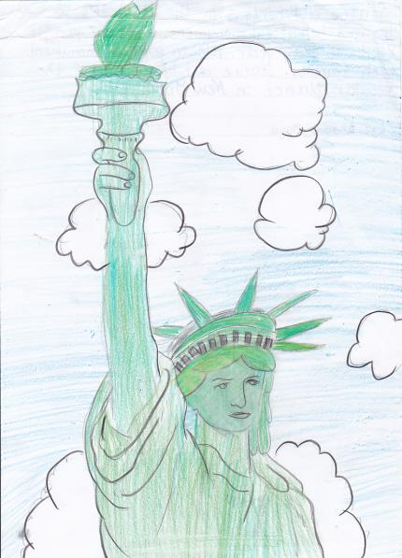
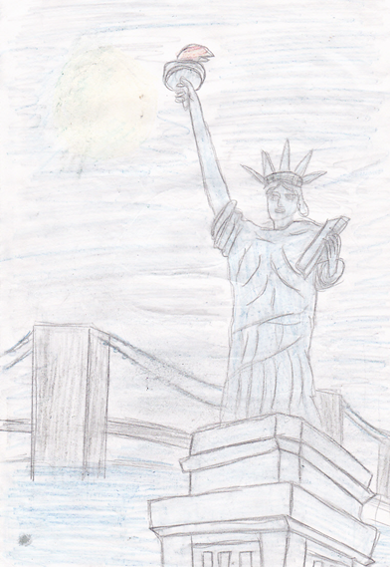

Slide 30
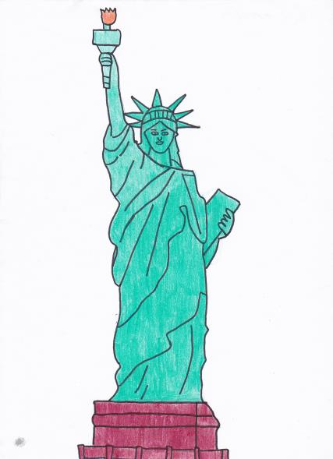
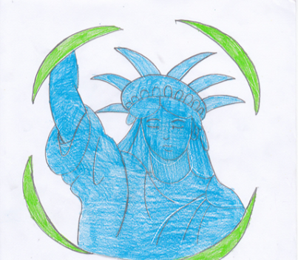

Slide 31
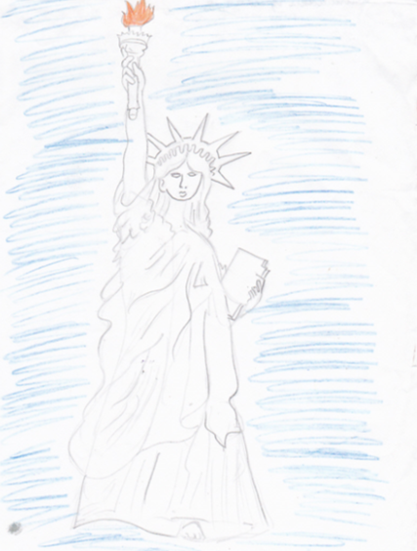
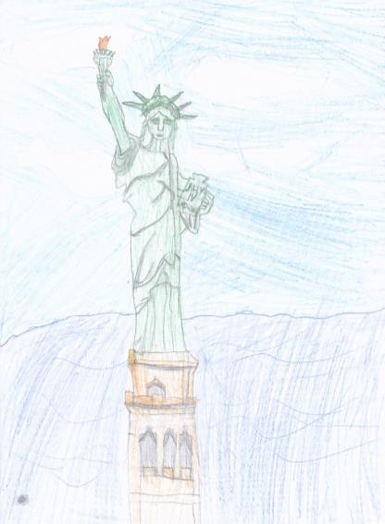

Slide 32
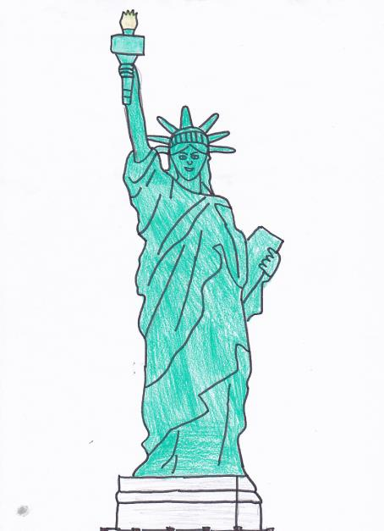

Slide 33
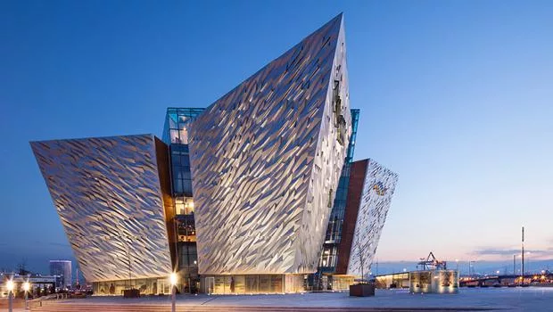
Titanic Belfast is a visitor attraction and a monument to Belfast's maritime heritage .

Slide 34
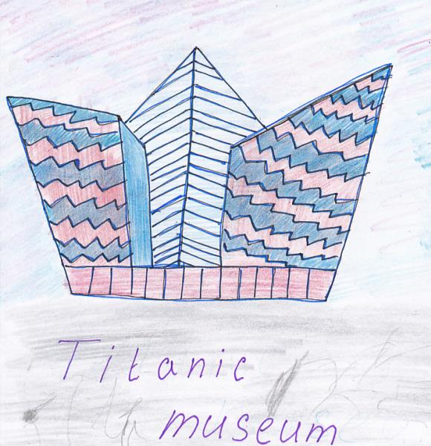

Slide 35
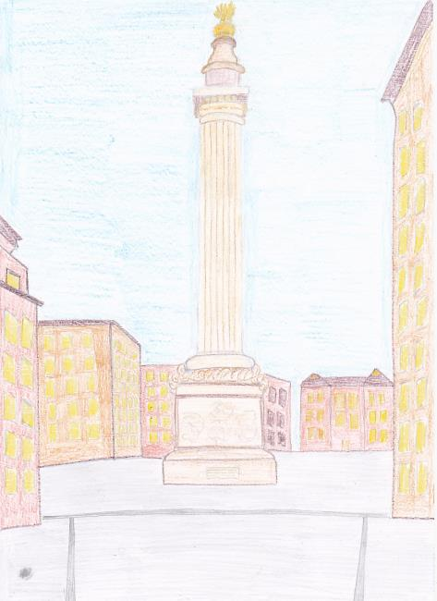

Slide 36
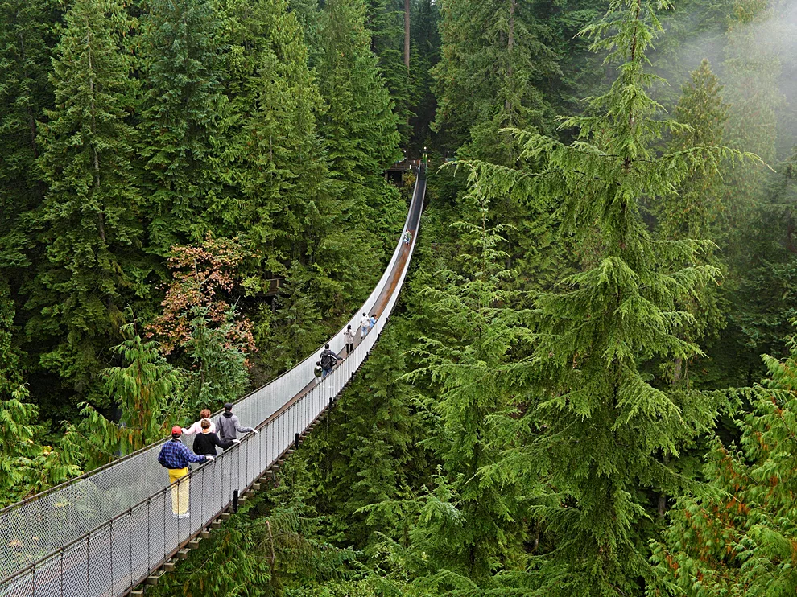
The Suspension Bridge of Capilano. I painted the "Capilano Bridge" from Canada. But in its current form. Previously, he looked completely different. The bridge was built in 1889, exactly 128 years ago.

Slide 37
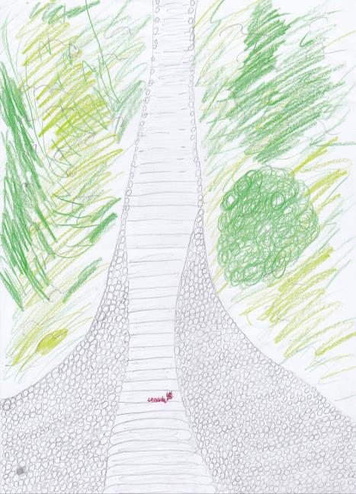

Slide 38
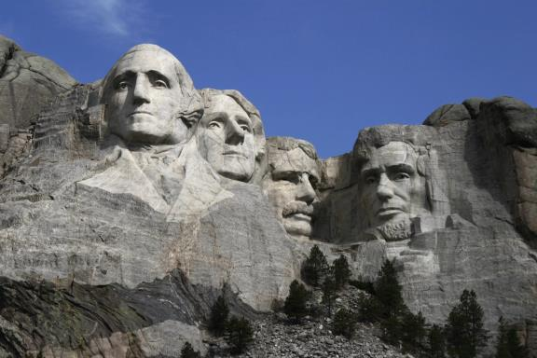
The Mount Rushmore National Memorial is a real symbol of USA and one of the most popular attractions. It is near Keystone, South Dakota. The likenesses of the great former U. S. presidents - George Washington, Thomas Jefferson, Theodore Roosevelt and Abraham Lincoln - are carved in the granite rock of the Mount Rushmore.

Slide 39
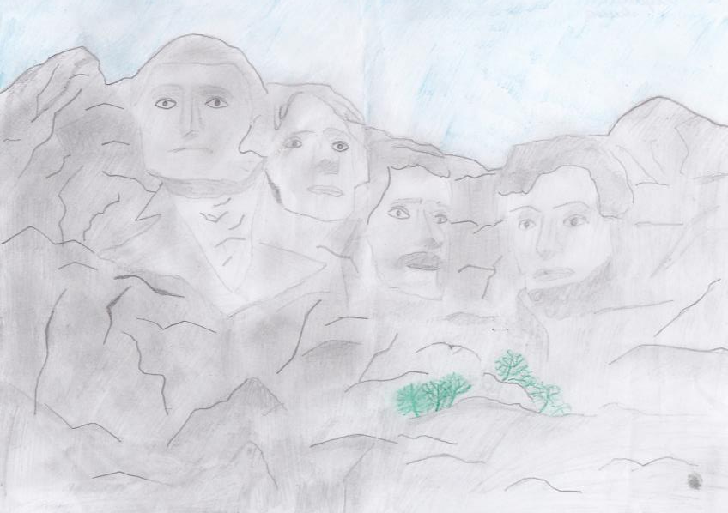

Slide 40
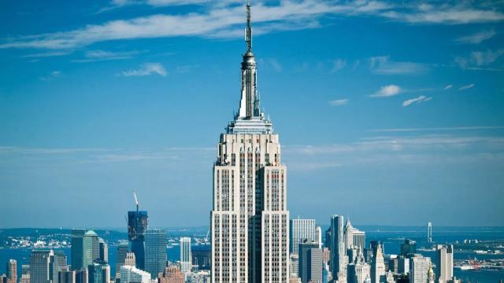
The Empire State Building is a 102-story Art Deco skyscraper on Fifth Avenue between West 33rd and 34th Streets in Midtown Manhattan, New York City.

Slide 41
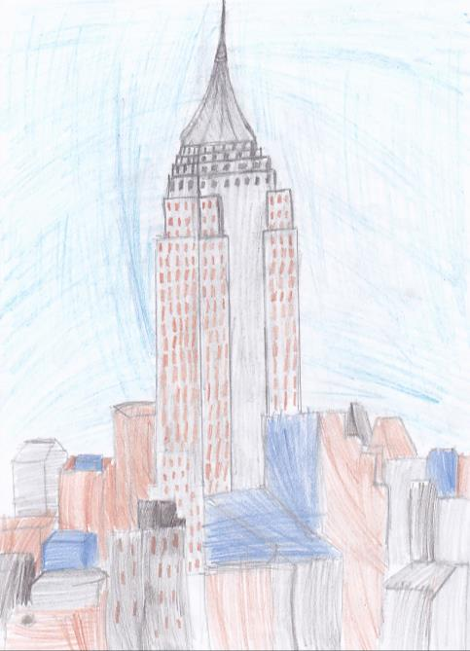

Slide 42

The Stonehenge stone circles are in England. People transported the first stones to this place about 5000 years ago. People built Stonehenge with bluestones and sarsen stones. There were about 80 bluestones. They came from mountains 250 kilometers away. It's still a special place for some people today. Every year, on June 21st, lots of people go to Stonehenge to celebrate the longest day of the year.

Slide 43


Slide 44


Slide 45


Slide 46


Slide 47


Slide 48

The kangaroo

Slide 49


Slide 50

Loch Ness is the home of probably the world’s most famous monster. The Loch Ness Monster is a very large animal, supposed to live in Loch Ness (It's a very deep lake in Northern Scotland.) People say that the Loch Ness Monster doesn't look like any other animal alive today. Although some people believe this creature really exists and say they have seen it, there is no scientific proof and for most people it's just a story. It is often shown in pictures as a creature like a large black or blue dinosaur.

Slide 51


Slide 52

Universal Studios Hollywood is a film studio and theme park in the San Fernando Valley area of Los Angeles County, California. It is one of the oldest and most famous Hollywood film studios still in use. Its official marketing headline is "The Entertainment Capital of LA". In 2016, the park hosted 8,086,000 guests, ranking it 15th in the world and 9th among North American parks. With thrilling theme park rides and shows, a real working movie studio and Los Angeles’ best shops, restaurants and cinemas at CityWalk, Universal Studios Hollywood is a unique experience that’s fun for the whole family.

Slide 53


Slide 54

The Hollywood Sign is an American cultural icon and landmark located in Los Angeles, California.
"HOLLYWOOD" is spelled out in white capital letters. Each letter was 9 m in width and 15 m in height and contained about 4 thousand bulbs. The sign has been officially open on July 13, 1923.

Slide 55


Slide 56

Das Schloss Neuschwanstein steht oberhalb von Hohenschwangau bei Füssen im südlichen Bayern. Der Bau wurde ab 1869 für den bayerischen König Ludwig II. als idealisierte Vorstellung einer Ritterburg aus der Zeit des Mittelalters errichtet. . Der König lebte nur wenige Monate im Schloss, er starb noch vor der Fertigstellung der Anlage. Neuschwanstein ist das berühmteste der Schlösser Ludwigs II. und eine der bekanntesten Sehenswürdigkeiten Deutschlands. Es wird jährlich von etwa 1,5 Millionen Touristen besucht.

Slide 57

Die Heilig-Kreuz-Kirche in Frankfurt (Oder) ist eine römisch-katholische Kirche im Zentrum der Stadt. Sie befindet sich an der Franz-Mehring-Straße westlich des Lennéparks.Der Name Heilig Kreuz wurde von der ursprünglich in der Grapengießer Gasse (Regierungsstraße) zu findenden Kirche übernommen. Der Doppelname entstand auf den Wunsch des zur Zeit der Segnung bereits verstorbenen Pfarrers Julius Winkler, der die Kirche Rosenkranz-Kirche nennen wollte. Das Glasmosaik über dem Hauptportal weist noch heute auf den Rosenkranz hin.

Slide 58


